Slide 1


MetaOutput
Work with output data never been so simple!
Notes:
Text To Speech (TTS) service used for recitation is https://ttsmp3.com/
Used voice is US English / Joanna.
In comments is written text for recitation.
METAOUTPUT <break time="1s"/>
Work with output data never been so simple!

Slide 2
WHAT IS METAOUTPUT?
MetaOutput is attempt to reinvent the most used tools of any Integrated Development Environment (IDE).
Functionality of all these tools is moved to single tool.
Result became simpler, smaller, faster and more functional than existing equivalents.
Notes:
WHAT IS METAOUTPUT? <break time="1s"/>
METAOUTPUT is attempt to reinvent the most used tools of any Integrated Development Environment (IDE). <break time="0.5s"/>
Functionality of all these tools is moved to single tool. <break time="0.5s"/>
Result became simpler, smaller, faster and more functional than existing equivalents.

Slide 3
WHY METAOUTPUT WAS MADE?
Development of standard output tool is frozen, but it’s too week to be enough.
Nobody improve it and it was a reason why MetaOutput was created.
Notes:
WHY METAOUTPUT WAS MADE? <break time="1s"/>
Development of standard output tool is frozen, but it’s too week to be enough. <break time="0.5s"/>
Nobody improve it <break time="0.2s"/> and it was a reason why METAOUTPUT was created.

Slide 4
WHY METAOUTPUT IS DIFFER FROM ALL?
MetaOutput is based on this approach:
Output data / log files - IT’S NOT A TEXT!
It’s look strange but seems almost nobody use this idea in own software products.
Notes:
WHY METAOUTPUT IS DIFFER FROM ALL? <break time="1s"/>
METAOUTPUT is based on this approach: <break time="0.5s"/>
Output data / log files - its NOT A TEXT! <break time="0.7s"/>
It’s look strange <break time="0.2s"/> but seems almost nobody use this idea in own software products.

Slide 5
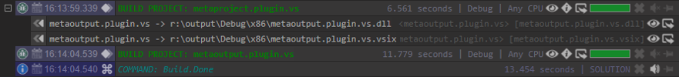
WHAT IS BASE OF METAOUTPUT?
Each trace message is complicated object with own visualization:
It consist of next blocks:
Content (main text);
Comment (text on the right);
Message source and type (icons on the left);
Timestamp (date and time of on the left);
Operations with message (buttons on the right).
Notes:
WHAT IS BASE OF METAOUTPUT? <break time="1s"/>
Each trace message is complicated object with own visualization: <break time="0.5s"/>
It consist of next blocks: <break time="0.5s"/>
Content <break time="0.3s"/> (main text); <break time="0.5s"/>
Comment <break time="0.3s"/> (text on the right); <break time="0.5s"/>
Message source and type <break time="0.3s"/> (icons on the left); <break time="0.5s"/>
Timestamp <break time="0.3s"/> (date and time of on the left); <break time="0.5s"/>
Operations with message <break time="0.3s"/> (buttons on the right).

Slide 6
WHICH GOALS SHOULD BE ACHIEVED?
MetaOutput should solve only 3 problem: simplicity, simplicity and simplicity.
Simply to learn it;
Simply to use it;
Simply to change it.
Notes:
WHICH GOALS SHOULD BE ACHIEVED? <break time="1s"/>
METAOUTPUT should solve only 3 problem: <break time="0.2s"/>simplicity, <break time="0.2s"/> simplicity <break time="0.2s"/> and simplicity. <break time="0.5s"/>
Simply to learn it; <break time="0.5s"/>
Simply to use it; <break time="0.5s"/>
Simply to change it.

Slide 7
GOAL: SUPPORT ANY DATA COMPLEXITY
Doesn't matter which kind of data is used, it should be visualized in natural form.
Everything must be clear without any learning and any explanations.
Notes:
GOAL: <break time="0.5s"/> SUPPORT ANY DATA COMPLEXITY <break time="1s"/>
Doesn't matter which kind of data is used, it should be visualized in natural form. <break time="0.5s"/>
Everything must be clear without any learning and any explanations.

Slide 8
GOAL: SUPPORT ANY DATA TYPES
Text messages, hierarchical data, audio, video, pictures or even HTML pages should be visualized as is directly from MetaOutput.
Notes:
GOAL: <break time="0.5s"/> SUPPORT ANY DATA TYPES <break time="1s"/>
Text messages, hierarchical data, audio, video, pictures or even HTML pages should be visualized as is directly from METAOUTPUT.

Slide 9
GOAL: VISUALIZE ANY DATA SOURCES
Data from different sources should be performed and visualized in one place simultaneously.
Notes:
GOAL: <break time="0.5s"/> VISUALIZE ANY DATA SOURCES <break time="1s"/>
Data from different sources should be performed and visualized in one place simultaneously.

Slide 10
GOAL: EVERYTHING IS POSSIBLE TO SEE
All data should have visual representation and be represented in clear form.
Everything should be obvious from first look.
Notes:
GOAL: <break time="0.5s"/> EVERYTHING IS POSSIBLE TO SEE <break time="1s"/>
All data should have visual representation and be represented in clear form. <break time="0.5s"/>
Everything should be obvious from first look.

Slide 11
GOAL: EVERYTHING IS POSSIBLE TO HEAR
Everything that requires especial attention should have possibility to be played by Text To Speech mechanism.
Notes:
GOAL: <break time="0.5s"/> EVERYTHING IS POSSIBLE TO HEAR <break time="1s"/>
Everything that requires especial attention should have possibility to be played by Text To Speech mechanism.

Slide 12
GOAL: EVERYTHING IS POSSIBLE TO FIND
Any trace message should be possible to find by text substring.
Search initiating and switching to found result should be obvious and fast.
Notes:
GOAL: <break time="0.5s"/> EVERYTHING IS POSSIBLE TO FIND <break time="1s"/>
Any trace message should be possible to find by text substring. <break time="0.5s"/>
Search initiating and switching to found result should be obvious and fast.

Slide 13
GOAL: EVERYTHING IS POSSIBLE TO FILTER
User should have possibility to change visibility of concrete messages or even whole sources.
Don’t want to see something – make it invisible…
Notes:
GOAL: <break time="0.5s"/> EVERYTHING IS POSSIBLE TO FILTER <break time="1s"/>
User should have possibility to change visibility of concrete messages or even whole sources. <break time="0.5s"/>
Don’t want to see something <break time="0.5s"/> – make it invisible…

Slide 14
GOAL: EVERYTHING IS POSSIBLE TO HIGHLIGHT
Everything that have special interest can be highlighted by desire of user.
Highlighted message or not highlighted should be obvious from first look.
Notes:
GOAL: <break time="0.5s"/> EVERYTHING IS POSSIBLE TO HIGHLIGHT <break time="1s"/>
Everything that have special interest can be highlighted by desire of user. <break time="0.5s"/>
Highlighted message or not highlighted should be obvious from first look.

Slide 15
GOAL: EVERYTHING SHOULD BE IN ONE PLACE
Many tools, much place for it, switching between it, rearrangement of it…
Forget it forever!
Only one place where all data will be collected and visualized.
Notes:
GOAL: <break time="0.5s"/> EVERYTHING SHOULD BE IN ONE PLACE <break time="1s"/>
Many tools, much place for it, switching between it, rearrangement of it… <break time="0.5s"/>
Forget it forever! <break time="0.5s"/>
Only one place where all data will be collected and visualized.

Slide 16
GOAL: EVERYTHING IN REAL TIME
Data collecting, transforming, filtering, highlighting and visualization should work simultaneously in real time without any delays.
Compilation process in parallel or executing of debugging program should not have any influence on work of application.
Everything must work quickly!
Notes:
GOAL: <break time="0.5s"/> EVERYTHING IN REAL TIME <break time="1s"/>
Data collecting, transforming, filtering, highlighting and visualization should work simultaneously in real time without any delays. <break time="0.5s"/>
Compilation process in parallel or executing of debugging program should not have any influence on work of application. <break time="0.5s"/>
Everything must work quickly!

Slide 17
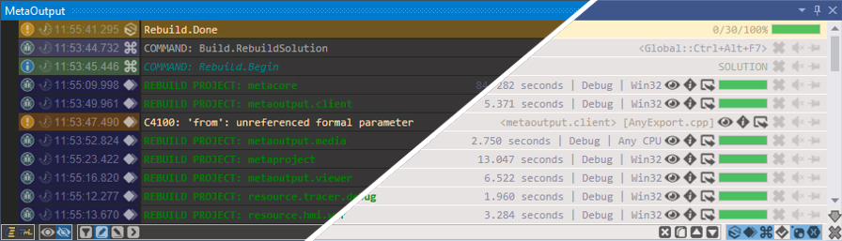
ADAPTATION TO COLOR SCHEMA
MetaOutput supports native for IDE color schemas:
This screenshot demonstrates dark and light color schemas.
Notes:
ADAPTATION TO COLOR SCHEMA <break time="1s"/>
METAOUTPUT supports native for IDE color schemas: <break time="0.5s"/>
This screenshot demonstrates dark and light color schemas.

Slide 18
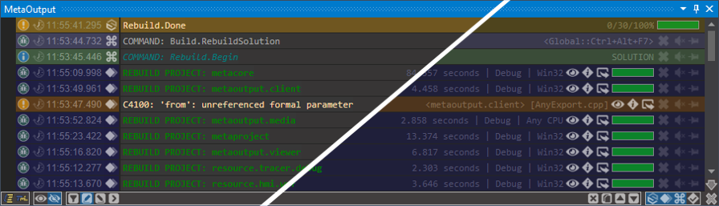
ADAPTATION TO USER PREFERENCES
MetaOutput supports several message line styles (disabled, half-line, full-line):
This screenshot demonstrates half-line and full-line visualization.
Notes:
ADAPTATION TO USER PREFERENCES <break time="1s"/>
METAOUTPUT supports several message line styles <break time="0.3s"/> (disabled, half-line, full-line): <break time="0.5s"/>
This screenshot demonstrates half-line and full-line visualization.

Slide 19
































VISUALIZATION OF DEFAULT SOURCES
MetaOutput supports these sources for all IDEs by default:
Notes:
VISUALIZATION OF DEFAULT SOURCES <break time="1s"/>
METAOUTPUT supports these sources for all IDEs by default:

Slide 20









VISUALIZATION OF ADDITIONAL SOURCES
List of supported sources can be easily extended.
These sources are additionally available in Visual Studio by default:
Also, own sources can be added using TML.
This is example how to do it:
@@@SOURCE.APPEND <<<OWN_SOURCE_NAME>>> /some_folder/own_source_name.png
Notes:
VISUALIZATION OF ADDITIONAL SOURCES <break time="1s"/>
List of supported sources can be easily extended. <break time="0.5s"/>
These sources are additionally available in Visual Studio by default: <break time="0.1s"/>
Also, own sources can be added using TML. <break time="0.5s"/>
Example on the screen demonstrates how to do it.

Slide 21

























VISUALIZATION OF DEFAULT TYPES
MetaOutput supports these types for all IDEs by default:
Notes:
VISUALIZATION OF DEFAULT TYPES <break time="1s"/>
METAOUTPUT supports these types for all IDEs by default:

Slide 22
VISUALIZATION OF SPECIFIC TYPES
List of supported types can be easily extended using TML.
This is example how to do it:
@@@TYPE.APPEND <<<OWN_TYPE_NAME>>> /some_folder/own_type_name.png
Notes:
VISUALIZATION OF SPECIFIC TYPES <break time="1s"/>
List of supported types can be easily extended using TML. <break time="0.5s"/>
Example on the screen demonstrates how to do it.

Slide 23



































VISUALIZATION OF UNKNOWN FILE FORMATS
MetaOutput doesn’t know all existing file formats, it is impossible!
However, it became possible using extensions to this product.
Now is written support for next file formats:
Notes:
VISUALIZATION OF UNKNOWN FILE FORMATS <break time="1s"/>
METAOUTPUT doesn’t know all existing file formats, it is impossible! <break time="0.5s"/>
However, it became possible using extensions to this product. <break time="0.5s"/>
Now is written support for next file formats: <break time="0.5s"/>
List on the screen.

Slide 24
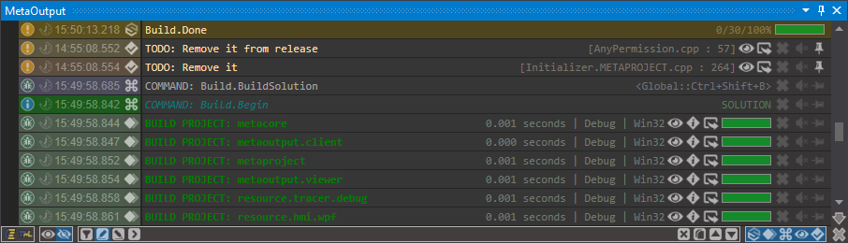
VISUALIZATION OF SEVERAL SOURCES
Trace messages can be visualized from several sources simultaneously:
Notes:
VISUALIZATION OF SEVERAL SOURCES <break time="1s"/>
Trace messages can be visualized from several sources simultaneously:

Slide 25
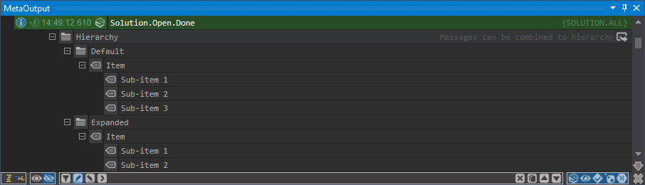
VISUALIZATION OF HIERARCHICAL DATA
Trace messages can be represented as hierarchical data with unlimited deep:
Notes:
VISUALIZATION OF HIERARCHICAL DATA <break time="1s"/>
Trace messages can be represented as hierarchical data with unlimited deep:

Slide 26
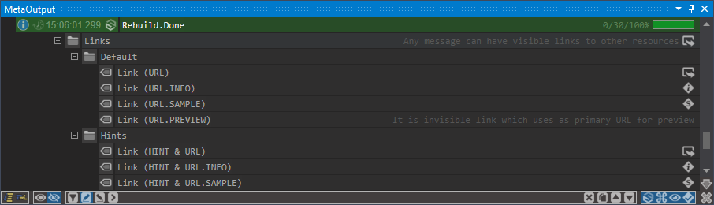
VISUALIZATION OF LINKS TO FILES
Trace messages can have different link buttons:
Notes:
VISUALIZATION OF LINKS TO FILES <break time="1s"/>
Trace messages can have different link buttons:

Slide 27
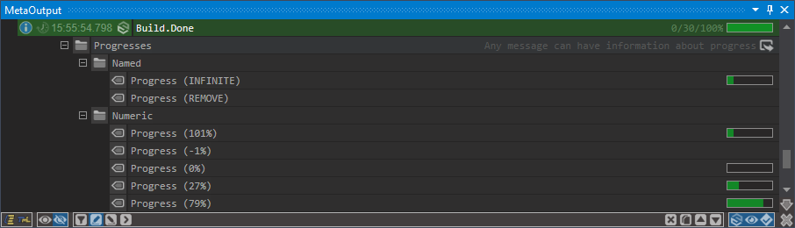
VISUALIZATION OF EXECUTION PROGRESS
Trace messages can visualize continuous operations:
Notes:
VISUALIZATION OF EXECUTION PROGRESS <break time="1s"/>
Trace messages can visualize continuous operations:

Slide 28
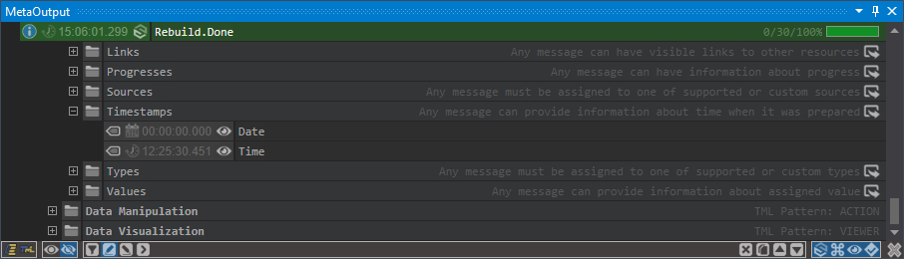
VISUALIZATION OF TIMESTAMPS
Trace messages can have timestamps with date and time:
Notes:
VISUALIZATION OF TIMESTAMPS <break time="1s"/>
Trace messages can have timestamps with date and time:

Slide 29
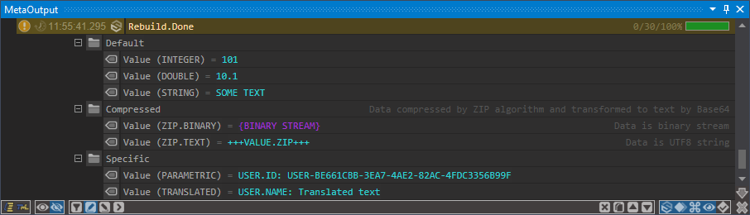
VISUALIZATION OF NAMED VALUES
Trace messages can be represented as NAME = VALUE:
Notes:
VISUALIZATION OF NAMED VALUES <break time="1s"/>
Trace messages can be represented as NAME = VALUE:

Slide 30
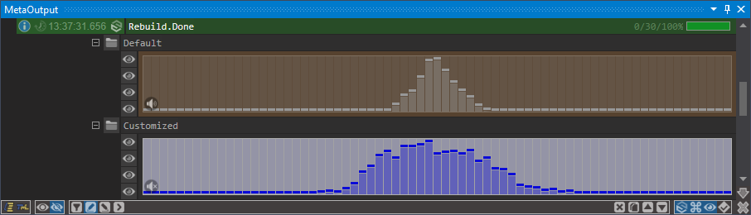
VISUALIZATION OF AUDIO FILES
Trace messages can visualize playing of audio files (placed locally or remote):
Notes:
VISUALIZATION OF AUDIO FILES <break time="1s"/>
Trace messages can visualize playing of audio files <break time="0.3s"/> (placed locally or remote):

Slide 31
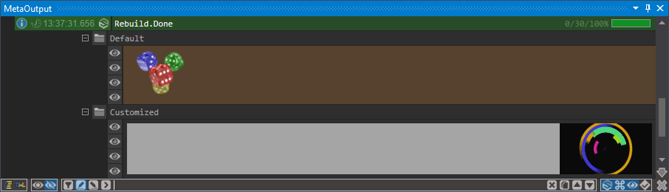
VISUALIZATION OF PICTURES
Trace messages can visualize picture files (placed locally or remote):
Notes:
VISUALIZATION OF PICTURES <break time="1s"/>
Trace messages can visualize picture files <break time="0.3s"/> (placed locally or remote):

Slide 32
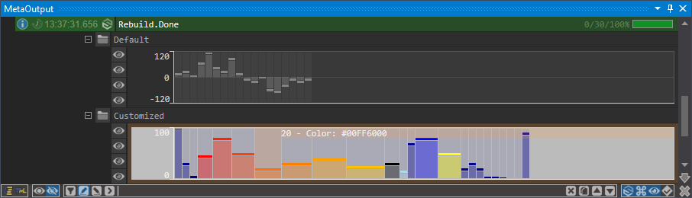
VISUALIZATION OF CHARTS
Trace messages can visualize chart diagrams:
Notes:
VISUALIZATION OF CHARTS <break time="1s"/>
Trace messages can visualize chart diagrams:

Slide 33
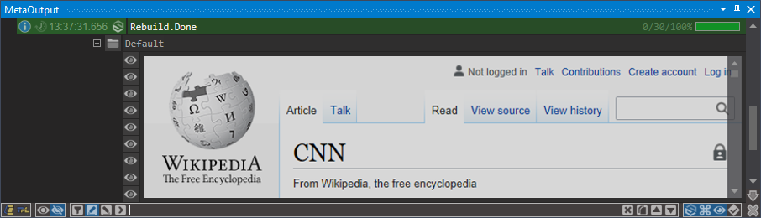
VISUALIZATION OF HTML FILES
Trace messages can visualize HTML files (placed locally or remote):
Notes:
VISUALIZATION OF HTML FILES <break time="1s"/>
Trace messages can visualize HTML files <break time="0.3s"/> (placed locally or remote):

Slide 34
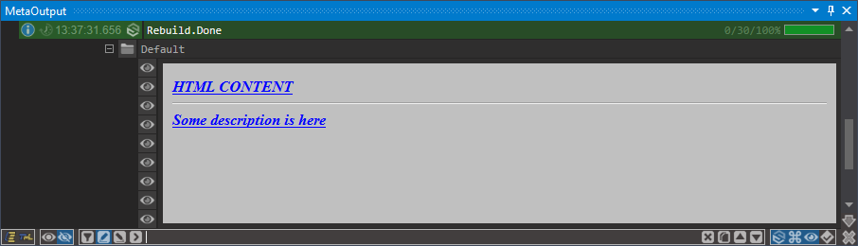
VISUALIZATION OF HTML CONTENT
Trace messages can visualize HTML content directly injected into the message:
Notes:
VISUALIZATION OF HTML CONTENT <break time="1s"/>
Trace messages can visualize HTML content directly injected into the message:

Slide 35
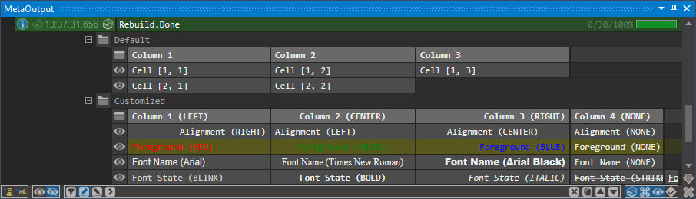
VISUALIZATION OF TABLES
Trace messages can visualize data tables:
Notes:
VISUALIZATION OF TABLES <break time="1s"/>
Trace messages can visualize data tables:

Slide 36
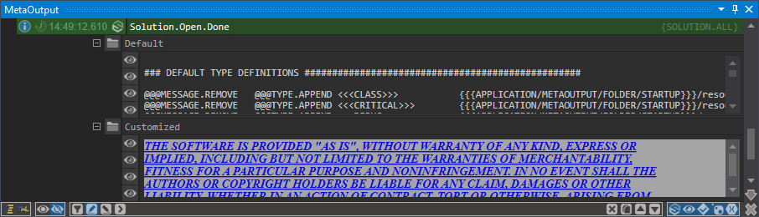
VISUALIZATION OF TEXT FILES
Trace messages can visualize text files (placed locally or remote):
Notes:
VISUALIZATION OF TEXT FILES <break time="1s"/>
Trace messages can visualize text files <break time="0.3s"/> (placed locally or remote):

Slide 37
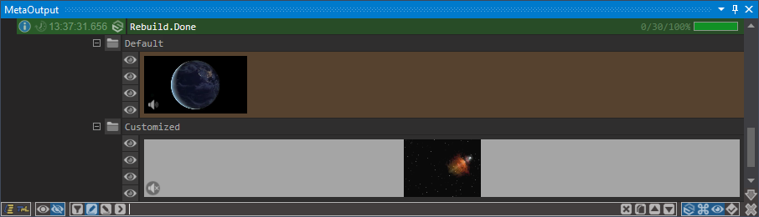
VISUALIZATION OF VIDEO FILES
Trace messages can visualize playing of video files (placed locally or remote):
Notes:
VISUALIZATION OF VIDEO FILES <break time="1s"/>
Trace messages can visualize playing of video files <break time="0.3s"/> (placed locally or remote):

Slide 38
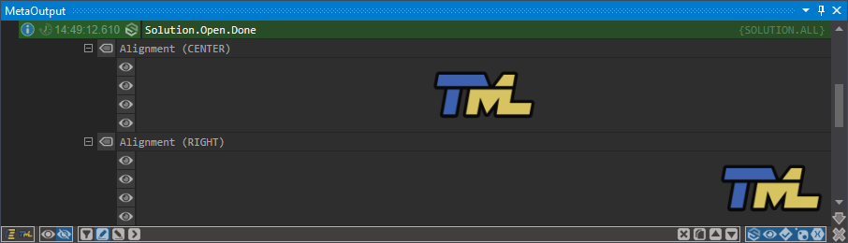
VISUALIZATION ATTRIBUTES: ALIGNMENTS
Some complex controls can have different alignments:
Notes:
VISUALIZATION ATTRIBUTES: <break time="0.5s"/> ALIGNMENTS <break time="1s"/>
Some complex controls can have different alignments:

Slide 39
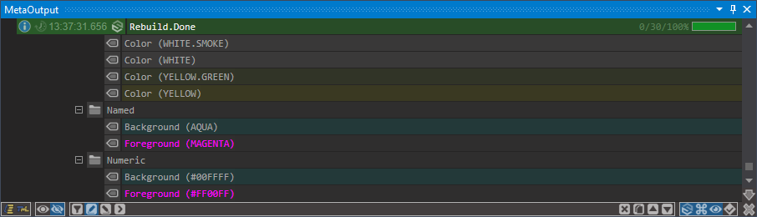
VISUALIZATION ATTRIBUTES: COLORS
Visual elements can have own background and foreground colors:
Notes:
VISUALIZATION ATTRIBUTES: <break time="0.5s"/> COLORS <break time="1s"/>
Visual elements can have own background and foreground colors:

Slide 40
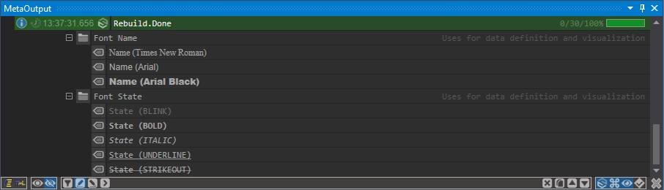
VISUALIZATION ATTRIBUTES: FONTS
Textual visual elements can use different font names and styles:
Notes:
VISUALIZATION ATTRIBUTES: <break time="0.5s"/> FONTS <break time="1s"/>
Textual visual elements can use different font names and styles:

Slide 41
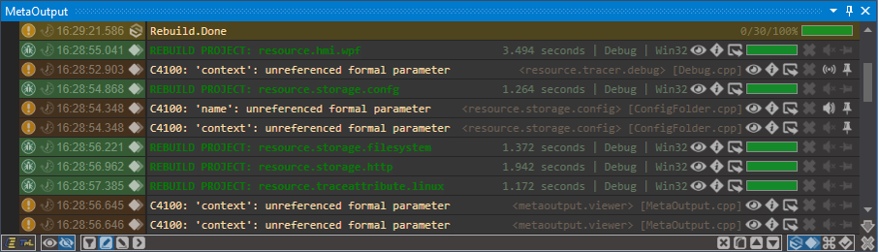
WHAT IS MESSAGE HIDING?
Any trace message can be hidden by desire of user:
By pressing of close button will be hidden all similar messages.
Visibility of hidden messages is possible to restore.
Notes:
WHAT IS MESSAGE HIDING? <break time="1s"/>
Any trace message can be hidden by desire of user: <break time="0.5s"/>
By pressing of close button will be hidden all similar messages. <break time="0.5s"/>
Visibility of hidden messages is possible to restore.

Slide 42
WHAT IS MESSAGE PLAYING?
Any trace message can be played by desire of user:
Such messages will be played by Text To Speech mechanism.
Notes:
WHAT IS MESSAGE PLAYING? <break time="1s"/>
Any trace message can be played by desire of user: <break time="0.5s"/>
Such messages will be played by Text To Speech mechanism.

Slide 43
WHAT IS PINNED MESSAGES?
Any trace message can be pinned by desire of user:
Such messages will not be removed on "Clear all" operation.
Notes:
WHAT IS PINNED MESSAGES? <break time="1s"/>
Any trace message can be pinned by desire of user: <break time="0.5s"/>
Such messages will not be removed on "Clear all" operation.

Slide 44
WHAT IS FILTERING?
Filtering its mechanism which simplify analyze of incoming data.
It can reduce amount of visible data and highlight some interesting messages.
Reducing of data is possible:
by hiding of not interesting messages;
by hiding of not interesting sources;
by hiding of all messages which don’t contain some substring (like grep).
Everything is working in real time.
Notes:
WHAT IS FILTERING? <break time="1s"/>
Filtering its mechanism which simplify analyze of incoming data. <break time="0.5s"/>
It can reduce amount of visible data and highlight some interesting messages. <break time="0.5s"/>
Reducing of data is possible: <break time="0.5s"/>
by hiding of not interesting messages; <break time="0.5s"/>
by hiding of not interesting sources; <break time="0.5s"/>
by hiding of all messages which don’t contain some substring <break time="0.5s"/> (like grep). <break time="0.5s"/>
Everything is working in real time.

Slide 45
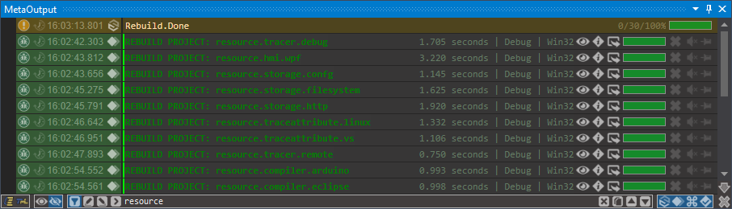
FILTER MODE: FILTER
Showing only that messages which have required substring:
New messages will be also filtered.
Notes:
FILTER MODE: <break time="0.5s"/> FILTER <break time="1s"/>
Showing only that messages which have required substring: <break time="0.5s"/>
New messages will be also filtered.

Slide 46
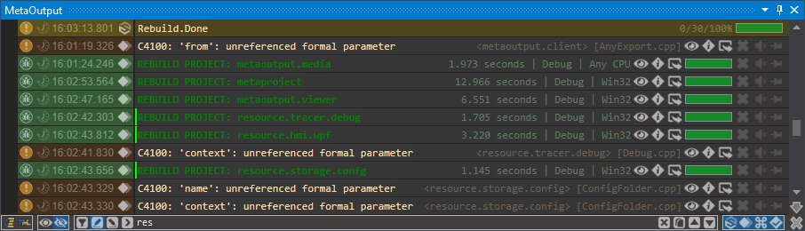
FILTER MODE: CONTENT HIGHLIGHT
Highlighting all messages which have required substring in content:
New messages will be also highlighted.
Notes:
FILTER MODE: <break time="0.5s"/> CONTENT HIGHLIGHT <break time="1s"/>
Highlighting all messages which have required substring in content: <break time="0.5s"/>
New messages will be also highlighted.

Slide 47
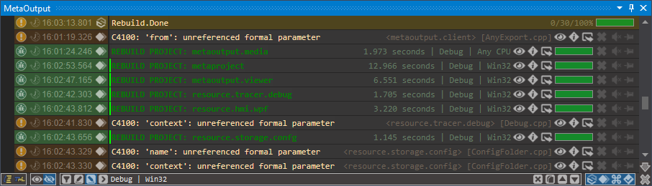
FILTER MODE: COMMENT HIGHLIGHT
Highlighting all messages which have required substring in comment:
New messages will be also highlighted.
Notes:
FILTER MODE: <break time="0.5s"/> COMMENT HIGHLIGHT <break time="1s"/>
Highlighting all messages which have required substring in comment: <break time="0.5s"/>
New messages will be also highlighted.

Slide 48
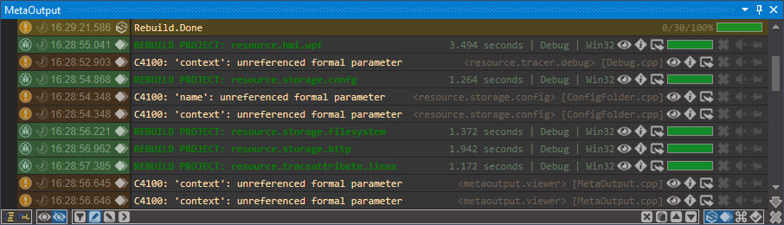
SOURCE FILTERING
User can show or hide any data source in one click:
Notes:
SOURCE FILTERING <break time="1s"/>
User can show or hide any data source in one click:

Slide 49
WHAT IS METAOUTPUT BUILDING?
MetaOutput provides completely new user experience in project building.
It give possibility to see current building process together with compilation errors and warnings.
Also available compilation status for each project and overall status.
Notes:
WHAT IS METAOUTPUT BUILDING? <break time="1s"/>
METAOUTPUT provides completely new user experience in project building. <break time="0.5s"/>
It give possibility to see current building process together with compilation errors and warnings. <break time="0.5s"/>
Also available compilation status for each project and overall status.

Slide 50
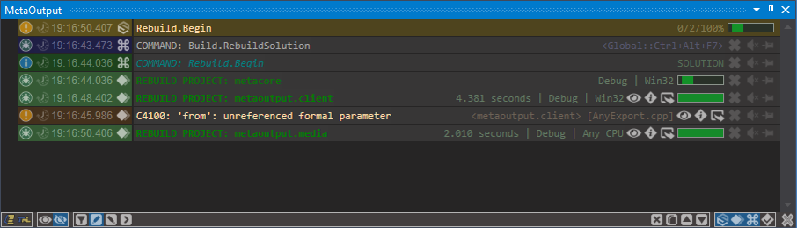
BUILDING: COMPILATION STATUS
Summary about how many projects compiled successfully and failed is here:
Notes:
BUILDING: <break time="0.5s"/> COMPILATION STATUS <break time="1s"/>
Summary about how many projects compiled successfully and failed is here:

Slide 51
BUILDING: COMPILATION PROCESS
Detailed information about build process is available for each project:
Notes:
BUILDING: <break time="0.5s"/> COMPILATION PROCESS <break time="1s"/>
Detailed information about build process is available for each project:

Slide 52
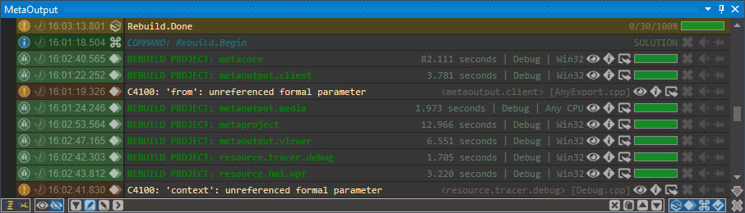
BUILDING: COMPILATION RESULTS
Detailed information about compilation results is available for each project:
Notes:
BUILDING: <break time="0.5s"/> COMPILATION RESULTS <break time="1s"/>
Detailed information about compilation results is available for each project:

Slide 53
WHAT IS METAOUTPUT DEBUGGING?
MetaOutput provides completely new user experience in software debugging.
It give possibility not only to see current state of application debugging, but to do it in the past.
It’s convenient mechanism, but also, it’s new vision of Time Travel Debugging.
Notes:
WHAT IS METAOUTPUT DEBUGGING? <break time="1s"/>
METAOUTPUT provides completely new user experience in software debugging. <break time="0.5s"/>
It give possibility not only to see current state of application debugging, but to do it in the past. <break time="0.5s"/>
It’s convenient mechanism, but also, it’s new vision of Time Travel Debugging.

Slide 54
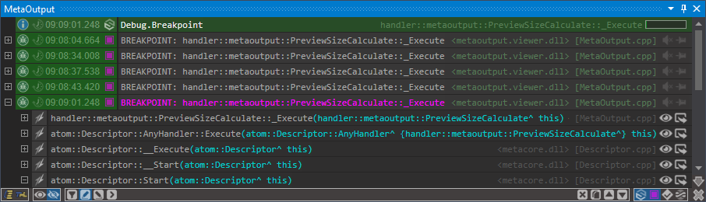
DEBUGGING: BREAKPOINTS
Detailed information is visualized for each application stops on breakpoints:
The latest breakpoint shows call stack automatically.
Notes:
DEBUGGING: <break time="0.5s"/> BREAKPOINTS <break time="1s"/>
Detailed information is visualized for each application stops on breakpoints: <break time="0.5s"/>
The latest breakpoint shows call stack automatically.

Slide 55
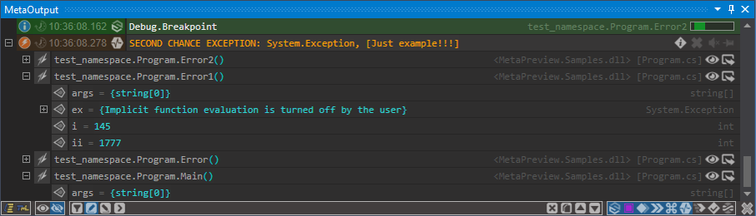
DEBUGGING: EXCEPTIONS
Detailed information is visualized for each thrown exceptions:
Stack trace with local variables is also available.
Notes:
DEBUGGING: <break time="0.5s"/> EXCEPTIONS <break time="1s"/>
Detailed information is visualized for each thrown exceptions: <break time="0.5s"/>
Stack trace with local variables is also available.

Slide 56
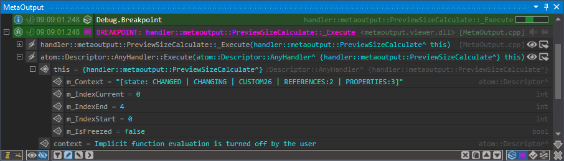
DEBUGGING: CALL STACKS
Call stack will be visualized for each breakpoint or exception:
Number of function calls can be restricted by user preferences.
Notes:
DEBUGGING: <break time="0.5s"/> CALL STACKS <break time="1s"/>
Call stack will be visualized for each breakpoint or exception: <break time="0.5s"/>
Number of function calls can be restricted by user preferences.

Slide 57
DEBUGGING: VARIABLES
Local variables can be visualized for each function call:
Amount of data can be restricted by timeout and deep of extracted data.
Notes:
DEBUGGING: <break time="0.5s"/> VARIABLES <break time="1s"/>
Local variables can be visualized for each function call: <break time="0.5s"/>
Amount of data can be restricted by timeout and deep of extracted data.

Slide 58
DEBUGGING: NESTINGS
Collecting of data for classes and structures can have different deep.
It can be restricted by user preferences and timeouts.
Notes:
DEBUGGING: <break time="0.5s"/> NESTINGS <break time="1s"/>
Collecting of data for classes and structures can have different deep. <break time="0.5s"/>
It can be restricted by user preferences and timeouts.

Slide 59
DEBUGGING: TIMEOUTS
Some function calls can have too many variables.
Their extraction can take a lot of time.
If to do it without any restrictions, this operation will make huge penalties for debugged process.
Therefore, data extracting will be stopped by ending of this operation or by exceeding of some interval of time.
Notes:
DEBUGGING: <break time="0.5s"/> TIMEOUTS <break time="1s"/>
Some function calls can have too many variables.
Their extraction can take a lot of time. <break time="0.5s"/>
If to do it without any restrictions, this operation will make huge penalties for debugged process. <break time="0.5s"/>
Therefore, data extracting will be stopped by ending of this operation or by exceeding of some interval of time.

Slide 60
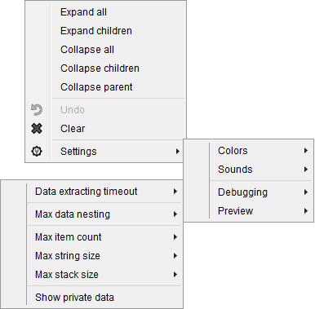
DEBUGGING: SETTINGS
User have possibility to change any preferences by popup menu:
Notes:
DEBUGGING: <break time="0.5s"/> SETTINGS <break time="1s"/>
User have possibility to change any preferences by popup menu:

Slide 61
WHAT IS TRACE MESSAGE LANGUAGE (TML)?
TML is new data definition language integrated into MetaOutput.
It can be used as substitution of XML, JSON, YAML, INI and other such languages;
It can be used as new standard for logging;
It can be used as new data container;
It can be easily extended for many other goals...
Notes:
WHAT IS TRACE MESSAGE LANGUAGE (TML)? <break time="1s"/>
TML is new data definition language integrated into METAOUTPUT. <break time="0.5s"/>
It can be used as substitution of XML, JSON, YAML, INI and other such languages; <break time="0.5s"/>
It can be used as new standard for logging; <break time="0.5s"/>
It can be used as new data container; <break time="0.5s"/>
It can be easily extended for many other goals...

Slide 62
IS TML ALREADY DEFINED AS STANDARD?
TML will be defined as ISO standard and specification will be available for all for free.
Any limitations with using, integrating to own products, commercial and noncommercial using will be absent.
However further development of this language MUST BE COORDINATED with author of this standard.
Notes:
IS TML ALREADY DEFINED AS STANDARD? <break time="1s"/>
TML will be defined as ISO standard and specification will be available for all for free. <break time="0.5s"/>
Any limitations with using, integrating to own products, commercial and noncommercial using will be absent. <break time="0.5s"/>
However further development of this language MUST BE COORDINATED with author of this standard.

Slide 63
WHERE TO GET INFORMATION ABOUT TML?
Will be prepared additional presentation about TML.
Notes:
WHERE TO GET INFORMATION ABOUT TML? <break time="1s"/>
Will be prepared additional presentation about TML.

Slide 64
HOW TO USE TML?
MetaOutput can visualize trace messages received from:
From source code:
C# - call function System.Diagnostics.Debug.WriteLine(tml_text);
C++ CLI - call function System::Diagnostics::Debug::WriteLine(tml_text);
C++ - call function OutputDebugString(tml_text);
From MetaOutput.Client library;
From <CONSOLE MODE> in MetaOutput.
Notes:
HOW TO USE TML? <break time="1s"/>
METAOUTPUT can visualize trace messages received from: <break time="0.5s"/>
From source code: <break time="0.5s"/>
From METAOUTPUT Client library; <break time="0.5s"/>
From CONSOLE MODE in METAOUTPUT.

Slide 65
USING TML: FROM SOURCE
This is example how to send TML message directly from source code:
System.Diagnostics.Debug.WriteLine(
"[[[Some message]]] " +
"@@@SOURCE COMMAND " +
"@@@TYPE INFO " +
"@@@COMMENT [[[Some comment]]] " +
"@@@FONT.STATE BLINK ITALIC " +
"@@@FOREGROUND TEAL");
Notes:
USING TML: <break time="0.5s"/> FROM SOURCE <break time="1s"/>
Example on the screen demonstrates how to send TML message directly from source code.

Slide 66
USING TML: FROM API
This is example how to send message using MetaOutput.Client library:
atom.Trace.GetInstance().
SetFontState(atom.Trace.NAME.FONT_STATE.BLINK).
SetFontState(atom.Trace.NAME.FONT_STATE.ITALIC).
SetForeground(atom.Trace.NAME.COLOR.TEAL).
SetComment("[[[Some comment]]]").
Send(atom.Trace.NAME.SOURCE.COMMAND, atom.Trace.NAME.TYPE.INFO, 0, "[[[Some message]]]");
Notes:
USING TML: <break time="0.5s"/> FROM API <break time="1s"/>
Example on the screen demonstrates how to send message using METAOUTPUT Client library.

Slide 67
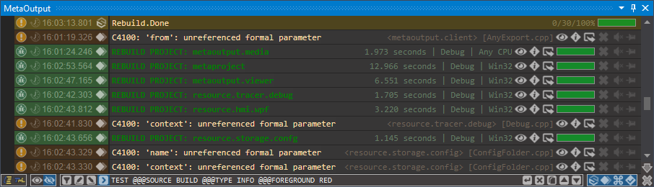
USING TML: FROM METAOUTPUT
New message is possible to send directly from MetaOutput using TML:
Notes:
USING TML: <break time="0.5s"/> FROM METAOUTPUT <break time="1s"/>
New message is possible to send directly from METAOUTPUT using TML:

Slide 68
WHAT IS TML PATTERNS?
TML pattern is official extension of TML.
Each such pattern add to TML new attributes which are focused on using in some application area.
Some patterns, which can be commonly used will be accepted as standard.
Notes:
WHAT IS TML PATTERNS? <break time="1s"/>
TML pattern is official extension of TML. <break time="0.5s"/>
Each such pattern add to TML new attributes which are focused on using in some application area. <break time="0.5s"/>
Some patterns, which can be commonly used will be accepted as standard.

Slide 69
TML PATTERN: TML.CORE
Pattern TML.CORE provides such functionality to TML:
Comments
Hierarchy
Links
Metadata
Sources
Timestamps
Types
Values
Notes:
TML PATTERN: <break time="0.5s"/> TML.CORE <break time="1s"/>
Pattern TML.CORE provides such functionality to TML: <break time="0.5s"/>
Comments <break time="0.3s"/>
Hierarchy <break time="0.3s"/>
Links <break time="0.3s"/>
Metadata <break time="0.3s"/>
Sources <break time="0.3s"/>
Timestamps <break time="0.3s"/>
Types <break time="0.3s"/>
Values

Slide 70
TML PATTERN: TML.ACTION
Pattern TML.ACTION provides such functionality to TML:
Commands
Conditions
Transformations
Translations
Variables
Notes:
TML PATTERN: <break time="0.5s"/> TML.ACTION <break time="1s"/>
Pattern TML.ACTION provides such functionality to TML: <break time="0.5s"/>
Commands <break time="0.3s"/>
Conditions <break time="0.3s"/>
Transformations <break time="0.3s"/>
Translations <break time="0.3s"/>
Variables

Slide 71
TML PATTERN: TML.VIEWER
Pattern TML.VIEWER add next functionality to TML:
Alignments
Colors
Controls
Fonts
Notes:
TML PATTERN: <break time="0.5s"/> TML.VIEWER <break time="1s"/>
Pattern TML.VIEWER add next functionality to TML: <break time="0.5s"/>
Alignments <break time="0.3s"/>
Colors <break time="0.3s"/>
Controls <break time="0.3s"/>
Fonts

Slide 72
HOW TO WRITE NEW TML PATTERNS?
This library is in development.
Notes:
HOW TO WRITE NEW TML PATTERNS? <break time="1s"/>
This library is in development.

Slide 73
COULD METAOUTPUT BE TRANSLATED?
MetaOutput uses English localization by default.
However, any string in user interface or any string in output can be translated to any other language using TML.
It can do any user which need it.
This is example demonstrates how to make it:
[[[TEST STRING]]] @@@TRANSLATION.APPEND <<<UA>>> [[[ТЕСТОВИЙ РЯДОК]]]
[[[TEST STRING]]] @@@TRANSLATION.APPEND <<<DE>>> [[[TESTSTRING]]]
[[[TEST STRING]]] @@@TRANSLATION.APPEND <<<IT>>> [[[STRINGA DI PROVA]]]
Notes:
COULD METAOUTPUT BE TRANSLATED? <break time="1s"/>
METAOUTPUT uses English localization by default. <break time="0.5s"/>
However, any string in user interface or any string in output can be translated to any other language using TML. <break time="0.5s"/>
It can do any user which need it. <break time="0.5s"/>
Example on the screen demonstrates how to make it.

Slide 74
WHAT IS METAOUTPUT EXTENSIONS?
MetaOutput provides basic functionality, and mechanism how to expend it.
This mechanism is small and simple and it available using MetaOutput.Client library.
This library is implemented as NuGet package and available here:
https://www.nuget.org/packages/MetaOutput.Client
This library is open-source and source files are available here:
https://github.com/viacheslav-lozinskyi/MetaOutput
Notes:
WHAT IS METAOUTPUT EXTENSIONS? <break time="1s"/>
METAOUTPUT provides basic functionality, and mechanism how to expend it. <break time="0.5s"/>
This mechanism is small and simple and it available using METAOUTPUT Client library. <break time="0.5s"/>
This library is implemented as NuGet package. It available by direct link is on the screen. <break time="0.5s"/>
This library is open-source and source files. It available by direct link is on the screen.

Slide 75
WHICH PLATFORMS ARE SUPPORTED?
Now implemented support only for .NET Framework 4.5+.
Support of the most popular platforms is planned.
Notes:
WHICH PLATFORMS ARE SUPPORTED? <break time="1s"/>
Now implemented support only for .NET Framework 4.5+. <break time="0.5s"/>
Support of the most popular platforms is planned.

Slide 76
WHICH LANGUAGES ARE SUPPORTED?
Now implemented support only for C# and C++ CLI.
Support of the most popular languages is planned.
Notes:
WHICH LANGUAGES ARE SUPPORTED? <break time="1s"/>
Now implemented support only for C Sharp and C++ CLI. <break time="0.5s"/>
Support of the most popular languages is planned.

Slide 77
METAOUTPUT EXTENSION: PREVIEW
This extension type is responsible for visualization of unknown for MetaOutput file formats.
For implementation is necessary to make inherited class:
class MyPreviewClass : extension.AnyPreview { … }
After that is necessary to make registration of this class:
extension.AnyPreview.Connect();
extension.AnyPreview.Register(“.PNG", new MyPreviewClass());
Notes:
METAOUTPUT EXTENSION: <break time="0.5s"/> PREVIEW <break time="1s"/>
This extension type is responsible for visualization of unknown for METAOUTPUT file formats. <break time="0.5s"/>
Example on the screen demonstrates how to make it.

Slide 78
METAOUTPUT EXTENSION: SOURCE
This extension type is responsible for sending to MetaOutput data from new sources.
For implementation is necessary to make inherited class:
class MySourceClass : extension.AnySource { … }
After that is necessary to make registration of this class:
extension.AnySource.Connect();
extension.AnySource.Register(new MySourceClass());
Notes:
METAOUTPUT EXTENSION: <break time="0.5s"/> SOURCE <break time="1s"/>
This extension type is responsible for sending to METAOUTPUT data from new sources. <break time="0.5s"/>
Example on the screen demonstrates how to make it.

Slide 79
METAOUTPUT EXTENSION: EXPORT
This extension type is responsible for sending data from MetaOutput to some specific file format (for example log file).
For implementation is necessary to make inherited class:
class MyExportClass : extension.AnyExport { … }
After that is necessary to make registration of this class:
extension.AnyExport.Connect();
extension.AnyExport.Register(new MyExportClass());
Notes:
METAOUTPUT EXTENSION: <break time="0.5s"/> EXPORT <break time="1s"/>
This extension type is responsible for sending data from METAOUTPUT to some specific file format (for example log file). <break time="0.5s"/>
Example on the screen demonstrates how to make it.

Slide 80
METAOUTPUT EXTENSION: IMPORT
This extension type is responsible for sending to MetaOutput imported data in some specific file format (for example log file).
For implementation is necessary to make inherited class:
class MyImportClass : extension.AnyImport { … }
After that is necessary to make registration of this class:
extension.AnyImport.Connect();
extension.AnyImport.Register(new MyImportClass());
Notes:
METAOUTPUT EXTENSION: <break time="0.5s"/> IMPORT <break time="1s"/>
This extension type is responsible for sending to METAOUTPUT imported data in some specific file format (for example log file). <break time="0.5s"/>
Example on the screen demonstrates how to make it.

Slide 81
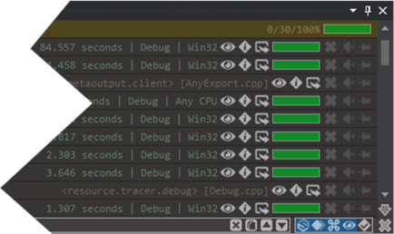
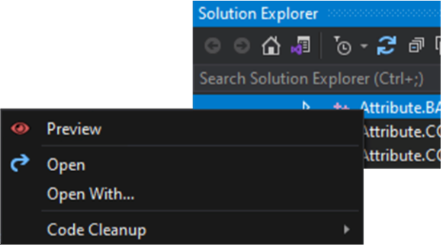
HOW TO USE EXTENSIONS?
Each file which have some URL can be previewed by installed extension.
If specialized extension is found, it will be responsible for visualization.
Otherwise, will be used generic mechanism.
Notes:
HOW TO USE EXTENSIONS? <break time="1s"/>
Each file which have some URL can be previewed by installed extension. <break time="0.5s"/>
If specialized extension is found, it will be responsible for visualization. <break time="0.5s"/>
Otherwise, will be used generic mechanism.

Slide 82
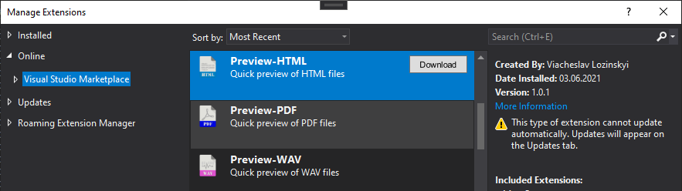
HOW TO INSTALL EXTENSIONS?
Installing of new extensions is possible from Visual Studio Marketplace:
https://marketplace.visualstudio.com/search?term=MetaOutput&target=VS&category=Tools
Also, it is possible to make directly from IDE:
Notes:
HOW TO INSTALL EXTENSIONS? <break time="1s"/>
Installing of new extensions is possible from Visual Studio Marketplace by link on the screen. <break time="0.5s"/>
Also, it is possible to make directly from IDE:

Slide 83
HOW TO WRITE NEW EXTENSIONS?
The simplest way to write MetaOutput extensions is to use MetaOutput.Client API.
It provide enough mechanisms to write next types of extensions:
PREVIEW (visualization of required file formats);
SOURCE (sending to MetaOutput data from some asynchronous source);
IMPORT (import data from file in required format to TML);
EXPORT (export data from TML to file in required format).
Notes:
HOW TO WRITE NEW EXTENSIONS? <break time="1s"/>
The simplest way to write METAOUTPUT extensions is to use METAOUTPUT Client API. <break time="0.5s"/>
It provide enough mechanisms to write next types of extensions: <break time="0.5s"/>
PREVIEW <break time="0.5s"/> (visualization of required file formats); <break time="0.5s"/>
SOURCE <break time="0.5s"/> (sending to METAOUTPUT data from some asynchronous source); <break time="0.5s"/>
IMPORT <break time="0.5s"/> (import data from file in required format to TML); <break time="0.5s"/>
EXPORT <break time="0.5s"/> (export data from TML to file in required format).

Slide 84
WHAT IS METAOUTPUT API?
MetaOutput provides several APIs for next goals:
Improvement of MetaOutput;
Using of MetaOutput control in own applications;
Using of Trace Message Language (TML) in own applications.
Notes:
WHAT IS METAOUTPUT API? <break time="1s"/>
METAOUTPUT provides several APIs for next goals: <break time="0.5s"/>
Improvement of METAOUTPUT; <break time="0.5s"/>
Using of METAOUTPUT control in own applications; <break time="0.5s"/>
Using of Trace Message Language (TML) in own applications.

Slide 85
METAOUTPUT API: CLIENT
This API provides possibility to write MetaOutput extensions.
MetaOutput.Client library is available here:
https://github.com/viacheslav-lozinskyi/MetaOutput
Samples with using of this API are here:
https://github.com/viacheslav-lozinskyi?tab=repositories
Notes:
METAOUTPUT API: <break time="0.5s"/> CLIENT <break time="1s"/>
This API provides possibility to write METAOUTPUT extensions. <break time="0.5s"/>
METAOUTPUT Client library is available by link on the screen. <break time="0.5s"/>
Samples with using of this API are available by link on the screen.

Slide 86
METAOUTPUT API: SERVER
This API provides possibility to integrate TML language to own application.
It will support all available TML patterns and provide possibility to include all available extensions.
Implementation is planned.
Notes:
METAOUTPUT API: <break time="0.5s"/> SERVER <break time="1s"/>
This API provides possibility to integrate TML language to own application. <break time="0.5s"/>
It will support all available TML patterns and provide possibility to include all available extensions. <break time="0.5s"/>
Implementation is planned.

Slide 87
METAOUTPUT API: VIEWER
This API provides possibility to integrate MetaOutput control to own application.
Implementation is planned.
Notes:
METAOUTPUT API: <break time="0.5s"/> VIEWER <break time="1s"/>
This API provides possibility to integrate METAOUTPUT control to own application. <break time="0.5s"/>
Implementation is planned.

Slide 88
INTEGRATION TO IDE
MetaOutput can be integrated into any IDE or editor using official plugin mechanism (only for that products, who provide such API).
It doesn’t provide any influence on existing functionality, and it is working in parallel with standard tools and installed extensions from other vendors.
Notes:
INTEGRATION TO IDE <break time="1s"/>
METAOUTPUT can be integrated into any IDE or editor using official plugin mechanism <break time="0.3s"/> (only for that products, who provide such API). <break time="0.5s"/>
It doesn’t provide any influence on existing functionality, and it is working in parallel with standard tools and installed extensions from other vendors.

Slide 89
INTEGRATION TO IDE: VISUAL STUDIO
Plugin for Visual Studio is already implemented.
Supported versions are: 2015, 2017, 2019, 2022.
Implementation is here: https://marketplace.visualstudio.com/items?itemName=ViacheslavLozinskyi.MetaOutput
Notes:
INTEGRATION TO IDE: <break time="0.5s"/> VISUAL STUDIO <break time="1s"/>
Plugin for Visual Studio is already implemented. <break time="0.5s"/>
Supported versions are: 2015, 2017, 2019, 2022. <break time="0.5s"/>
Link to this plugin is on the screen.

Slide 90
INTEGRATION TO IDE: VISUAL STUDIO CODE
Plugin for Visual Studio Code is not implemented yet.
Implementation is planned.
Notes:
INTEGRATION TO IDE: <break time="0.5s"/> VISUAL STUDIO CODE <break time="1s"/>
Plugin for Visual Studio Code is not implemented yet. <break time="0.5s"/>
Implementation is planned.

Slide 91
INTEGRATION TO IDE: ECLIPSE
Plugin for Eclipse is not implemented yet.
Implementation is planned.
Notes:
INTEGRATION TO IDE: <break time="0.5s"/> ECLIPSE <break time="1s"/>
Plugin for Eclipse is not implemented yet. <break time="0.5s"/>
Implementation is planned.

Slide 92
INTEGRATION TO IDE: XCODE
Plugin for XCode is not implemented yet.
Implementation is planned.
Notes:
INTEGRATION TO IDE: <break time="0.5s"/> XCODE <break time="1s"/>
Plugin for XCode is not implemented yet. <break time="0.5s"/>
Implementation is planned.

Slide 93
INTEGRATION TO IDE: OTHER IDE
Support for all popular IDEs will be implemented in any case.
Integration with other IDEs or editors is optional.
This is possible if owner of such product will finance this implementation and further support.
As alternative, development can be for free in case of significant promotion of MetaOutput.
If you are user of such IDE and want to use MetaOutput there, please send them this document. It will give possibility at least to start thinking about such project.
Notes:
INTEGRATION TO IDE: OTHER IDE <break time="1s"/>
Support for all popular IDEs will be implemented in any case. <break time="0.5s"/>
Integration with other IDEs or editors is optional. <break time="0.3s"/>
This is possible if owner of such product will finance this implementation and further support. <break time="0.5s"/>
As alternative, development can be for free in case of significant promotion of METAOUTPUT. <break time="0.5s"/>
If you are user of such IDE and want to use METAOUTPUT there, please send them this document. It will give possibility at least to start thinking about such project.

Slide 94

METAOUTPUT LICENSE
MetaOutput has proprietary license which provide next rights:
Permissions
Commercial use
Display
Distribution
Private use
Limitations
Disclosure
Liability
Modification
Warranty
Notes:
METAOUTPUT LICENSE <break time="1s"/>
METAOUTPUT has proprietary license which provide next rights: <break time="0.5s"/>
Permissions <break time="0.5s"/>
Commercial use. <break time="0.1s"/>
Display. <break time="0.1s"/>
Distribution. <break time="0.1s"/>
Private use.<break time="0.5s"/>
Limitations <break time="0.5s"/>
Disclosure. <break time="0.1s"/>
Liability. <break time="0.1s"/>
Modification. <break time="0.1s"/>
Warranty.

Slide 95

METAOUTPUT PRICE
MetaOutput is freeware software.
In future it will have additional services which will be available by subscription.
Notes:
METAOUTPUT PRICE <break time="1s"/>
METAOUTPUT is freeware software. <break time="0.5s"/>
In future it will have additional services which will be available by subscription.

Slide 96

ABOUT COMMUNITY
This community, it is about effectiveness.
Do more by less efforts!
Any ideas is here…
Any news is here…
Any questions is here too…
Join us!
Notes:
ABOUT COMMUNITY <break time="1s"/>
This community, it is about effectiveness. <break time="0.5s"/>
Do more by less efforts! <break time="0.5s"/>
Any ideas is here... <break time="0.5s"/>
Any news is here... <break time="0.5s"/>
Any questions is here too... <break time="1s"/>
Join us!

Slide 97
COMMUNITY: METAOUTPUT
Official community of MetaOutput is here:
Reddit: https://bit.ly/metaoutput-community-reddit
Notes:
COMMUNITY: <break time="0.5s"/> METAOUTPUT <break time="1s"/>
Official community of METAOUTPUT is available by link on the screen.

Slide 98

COMMUNITY: TML
Official community of TML is here:
Reddit: https://bit.ly/tml-community-reddit
Notes:
COMMUNITY: <break time="0.5s"/> TML <break time="1s"/>
Official community of TML is available by link on the screen.

Slide 99
ABOUT FEEDBACKS
Improvement of MetaOutput is impossible without feedbacks from real users.
It is very important part of development, and if you have some concerns or see any bug – don’t hesitate and report it!
All found bugs will be fixed (often in the nearest release).
All new feature requests will be performed (the most useful of them will be implemented).
Notes:
ABOUT FEEDBACKS <break time="1s"/>
Improvement of METAOUTPUT is impossible without feedbacks from real users. <break time="0.5s"/>
It is very important part of development, and if you have some concerns or see any bug <break time="0.5s"/> – don’t hesitate and report it! <break time="0.5s"/>
All found bugs will be fixed <break time="0.5s"/> (often in the nearest release). <break time="0.5s"/>
All new feature requests will be performed <break time="0.5s"/> (the most useful of them will be implemented).

Slide 100
FEEDBACKS: GIT
Primary place for reporting about any bugs and new features is here:
https://github.com/viacheslav-lozinskyi/MetaOutput/issues
Thanks in advance for any reported bug or feature request!
Notes:
FEEDBACKS: <break time="0.5s"/> GIT <break time="1s"/>
Primary place for reporting about any bugs and new features is on the screen: <break time="0.5s"/>
Thanks in advance for any reported bug or feature request!

Slide 101
FEEDBACKS: VISUAL STUDIO MARKETPLACE
Visual Studio Marketplace supports review mechanism.
It is placed here:
https://marketplace.visualstudio.com/items?itemName=ViacheslavLozinskyi.MetaOutput&ssr=false#review-details
Will be great to see your rating there.
It will help to promote MetaOutput and save time for development.
IT IS VERY IMPORTANT, and thanks in advance for any comment there!
Notes:
FEEDBACKS: <break time="0.5s"/> VISUAL STUDIO MARKETPLACE <break time="1s"/>
Visual Studio Marketplace supports review mechanism. <break time="0.5s"/>
Direct link is on the screen. <break time="0.5s"/>
Will be great to see your rating there. <break time="0.2s"/>
It will help to promote METAOUTPUT and save time for development. <break time="0.5s"/>
IT IS VERY IMPORTANT, and thanks in advance for any comment there!

Slide 102
ABOUT REPOSTS
MetaOutput is new product.
By functionality it hasn't competitors but has one drawback - IT IS UNKNOWN.
Any repost is your contribution into this product.
IT IS VERY IMPORTANT, and thanks in advance for reposts!
Notes:
ABOUT REPOSTS <break time="1s"/>
METAOUTPUT is new product. <break time="0.5s"/>
By functionality it hasn't competitors but has one drawback - <break time="0.5s"/> IT IS UNKNOWN. <break time="0.5s"/>
Any repost is your contribution into this product. <break time="0.5s"/>
IT IS VERY IMPORTANT, and thanks in advance for reposts!

Slide 103
ABOUT THIS DOCUMENT
This presentation was created by Viacheslav Lozinskyi.
Design of this document was made by Maria Lozinskaya.
The latest version of this document is available here:
https://bit.ly/metaoutput-presentation-pdf
The latest version of video presentation is available here:
https://bit.ly/metaoutput-presentation-youtube
Notes:
ABOUT THIS DOCUMENT <break time="1s"/>
This presentation was created by Viacheslav Lozinskiy. <break time="0.5s"/>
Design of this document was made by Maria Lozinskaya. <break time="0.5s"/>
Direct link to the latest version of this document is on the screen.

Slide 104
CONTACTS
Author and owner of MetaOutput is Viacheslav Lozinskyi.
Contacts are next:
Email: viacheslav.lozinskyi@gmail.com
LinkedIn: https://www.linkedin.com/in/viacheslav-lozinskyi-a70750177/
Notes:
CONTACTS <break time="1s"/>
Author and owner of METAOUTPUT is Viacheslav Lozinskiy. <break time="0.5s"/>
Actual email and LinkedIn is on the screen.

Slide 105
THANKS FOR WATCHING
Notes:
THANKS FOR WATCHING

